Slide 1

Data Engineering and Machine Learning Masterclass

Slide 2
01 Machine Learning Introduction
02 Python Introduction

Slide 3
03 Load, clean and encode data
04 Data engineering for machine learning
05 Build regression and discretizer models
06 Data transformation and feature selection for ridge regression

Slide 4
All source files provided!

Slide 5
Requirements

Slide 6
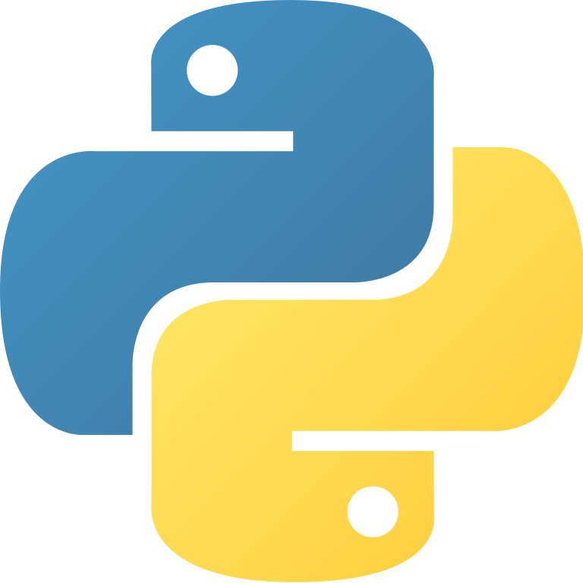
Python introduction included

Slide 7
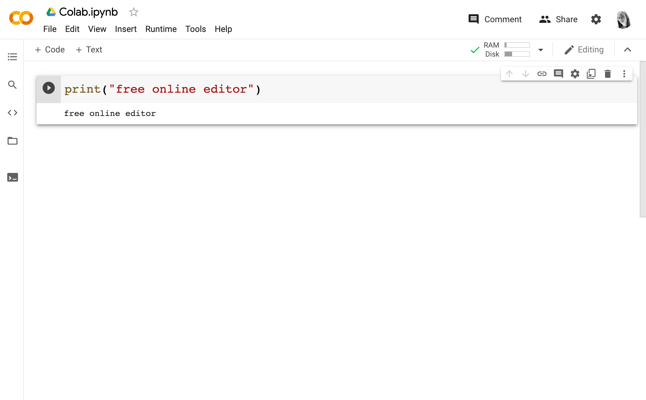
Code editor with Python support
Free online: Google Colab
https://colab.research.google.com
Or on your computer

Slide 8
Working with Google Colab
Variable values can get stuck.
If your changes don’t seem to update, restart the runtime.

Slide 9
How to Debug
Search your bug, problem or question via a search engine
Many answers on Stack Overflow
Join a Discord server

Slide 10
How to Debug
Visit the Github for the library that isn’t working
Visit the documentation for what you are struggling with

Slide 11
No installation required
No paid software required

Slide 12
Data Engineering and Machine Learning Masterclass

